Slide 1
Distributed ML with Apache Spark
By @satwikkansal

Slide 2
What is distributed computing?

Slide 3
Kinds of parallelism

Slide 4
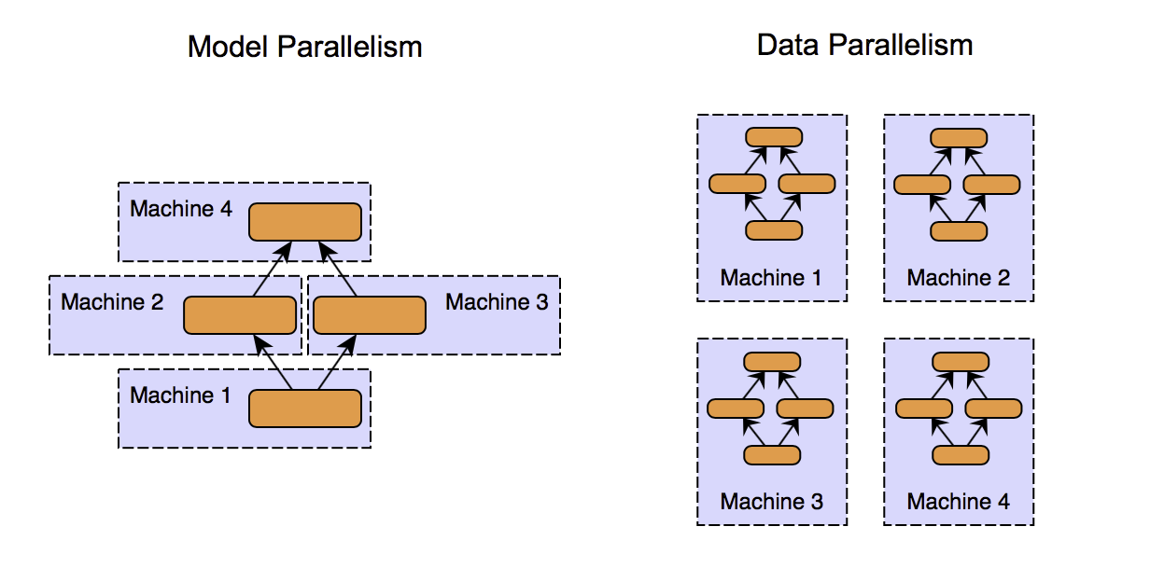

Slide 5
MapReduce programming paradigm

Slide 6
Spark Architecture

Slide 7
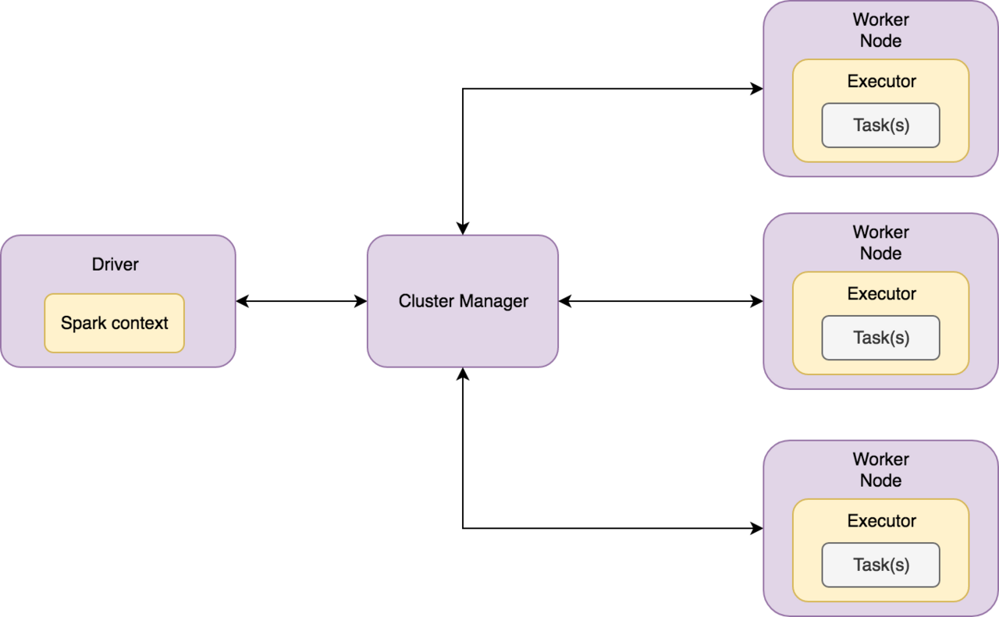

Slide 8
Let’s meet PySpark

Slide 9
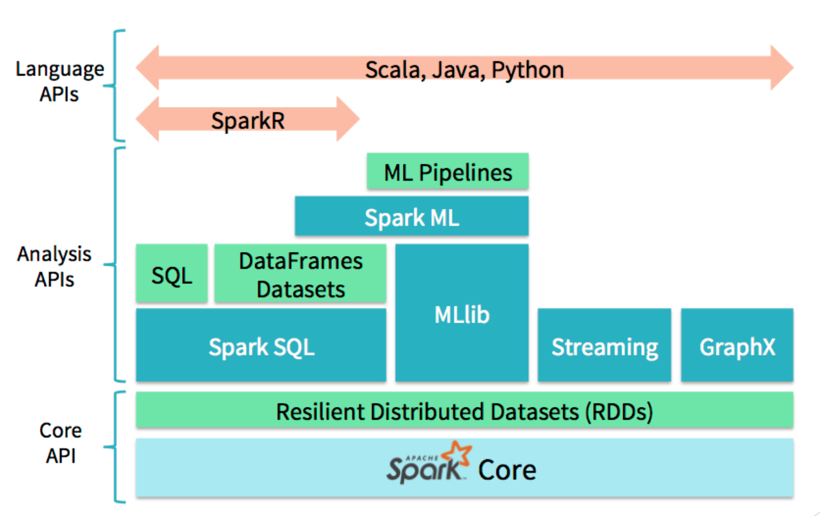

Slide 10
Hello PySpark! (PySpark hello world)

Slide 11
Some important PySpark constructs

Slide 12
RDDs

Slide 13
Lazy Execution

Slide 14
Execution phases in Spark

Slide 15
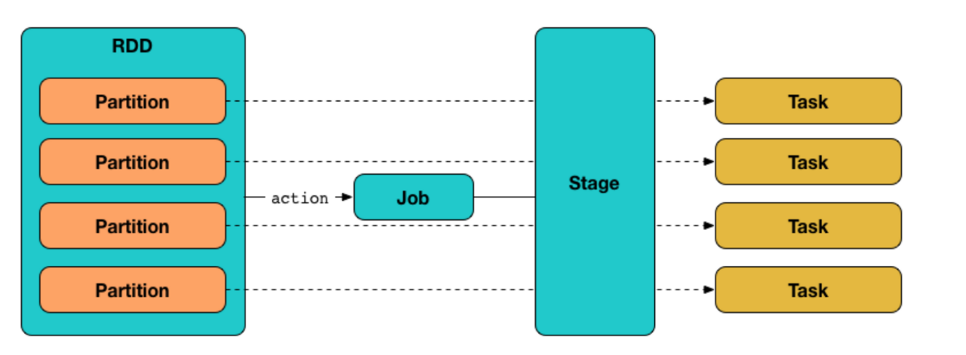

Slide 16
Useful Spark transform operations

Slide 17
Spark actions

Slide 18
Visualizing progress with Spark dashboard

Slide 19
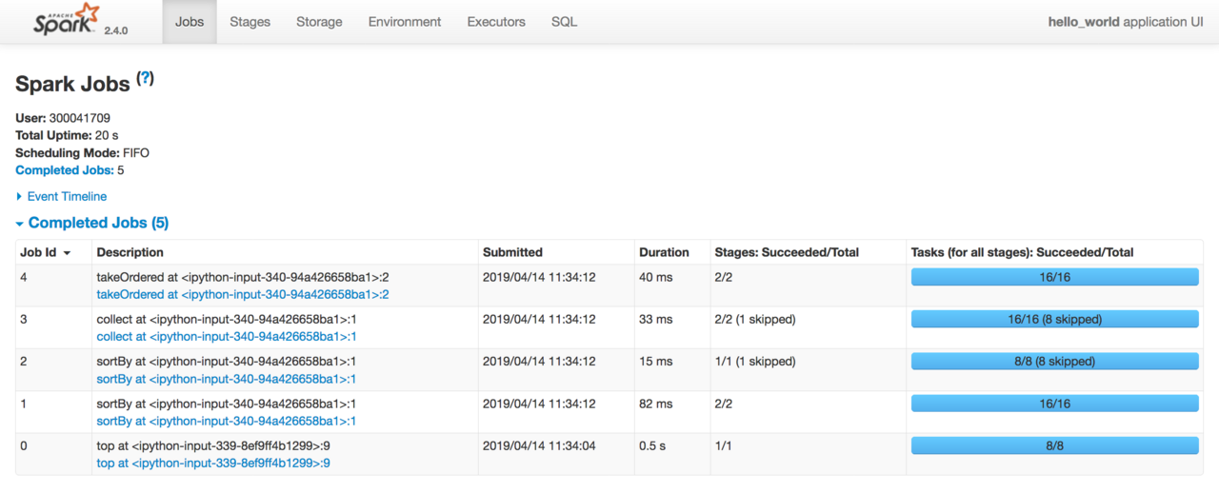

Slide 20
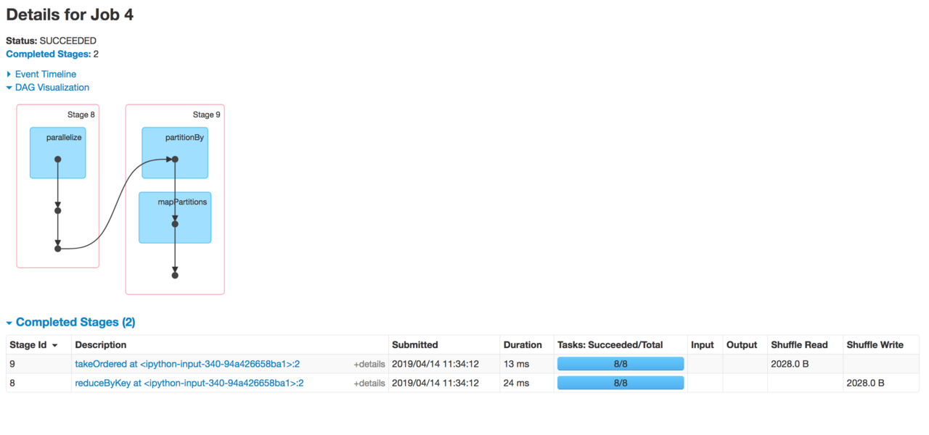

Slide 21
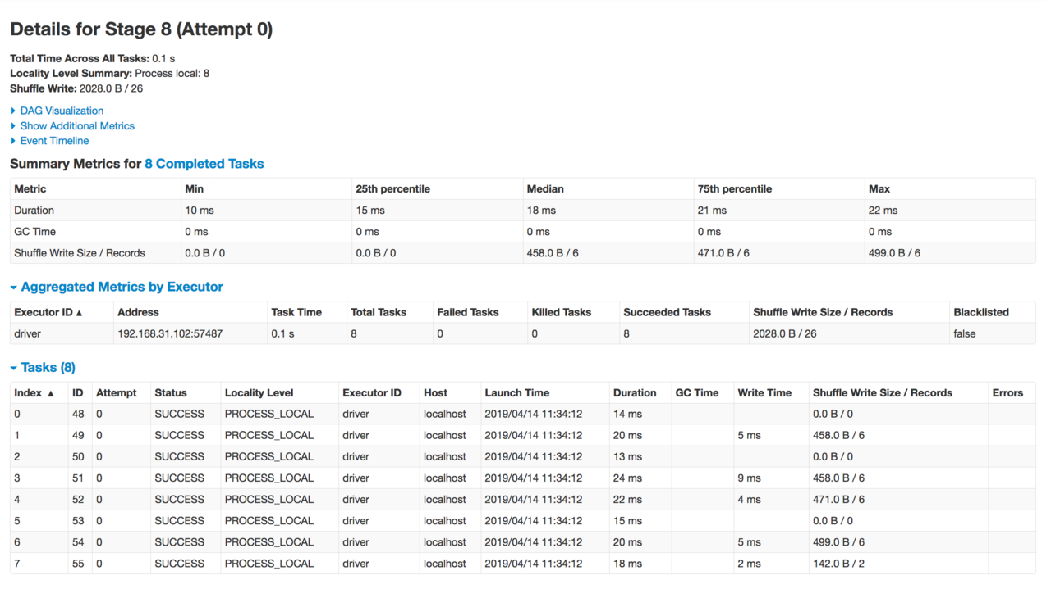

Slide 22
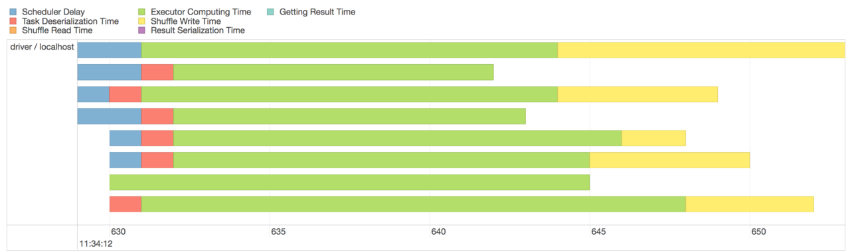

Slide 23
Let’s implement linear regression in PySpark

Slide 24
SparkML and MLlib

Slide 25
Cloud options available

Slide 26
Thank you!
A bit about me...
Former Software Developer
Co-founder @ Frobyt
Creative technologist, Author of “What the f*ck Python”
GSoC 17, GCI 17 mentor, GSoC-18 mentor
https://satwikkansal.xyz
Handle: @satwikkansal

